Slide 1
big o notation
Searching Algorithms

Slide 2
INTRODUCTION
Big O Notation is a way to measure an algorithm’s efficiency. It measures the time it takes to run your function as the input grows. Or in other words, how well does the function scale.
There are two parts to measuring efficiency — time complexity and space complexity. Time complexity is a measure of how long the function takes to run in terms of its computational steps. Space complexity has to do with the amount of memory used by the function. This blog will illustrate time complexity with two search algorithms.
Big O is sometimes referred to as the algorithm’s upper bound, meaning that it deals with the worst-case scenario. The best-case scenario doesn’t really tell us anything — it will be finding our item in the first pass. We use worst-case to remove uncertainty — the algorithm will never perform worse than we expect.

Slide 3
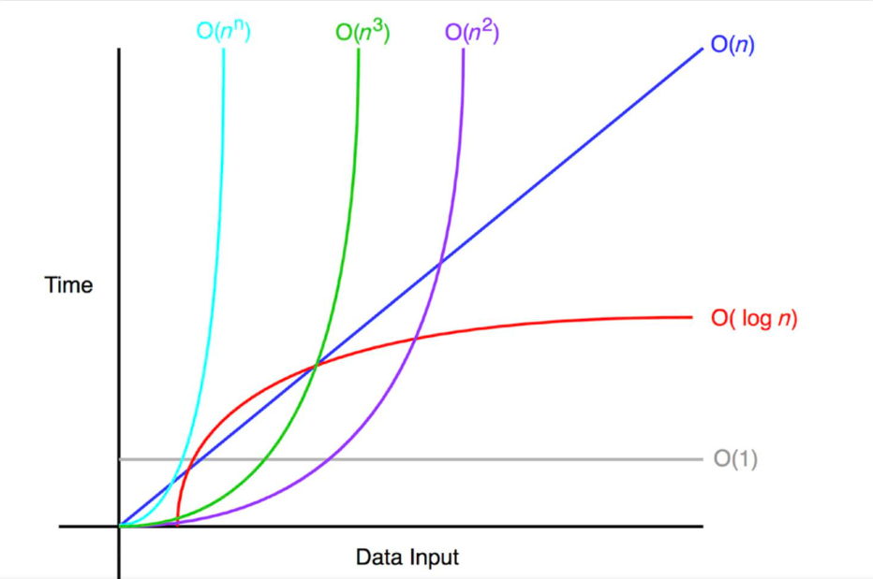
To measure the efficiency of an algorithm, we need to measure the two things. 1.Time complexity:How much time is needed to run an algorithm. 2.Space Complexity:How much space is needed to run an algorithm.

Slide 4
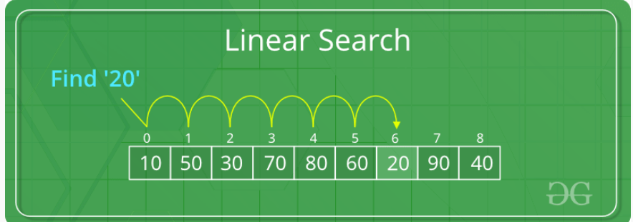
Linear Search example
Step 1: First, read the search element (Target element) in the array.
Step 2: In the second step compare the search element with the first element in the array.
Step 3: If both are matched, display “Target element is found” and terminate the Linear Search
function.
Step 4: If both are not matched, compare the search element with the next element in the array.
Step 5: In this step, repeat steps 3 and 4 until the search (Target) element is compared with the
last element of the array.
Step 6 – If the last element in the list does not match, the Linear Search Function will be
terminated, and the message “Element is not found” will be displayed.

Slide 5
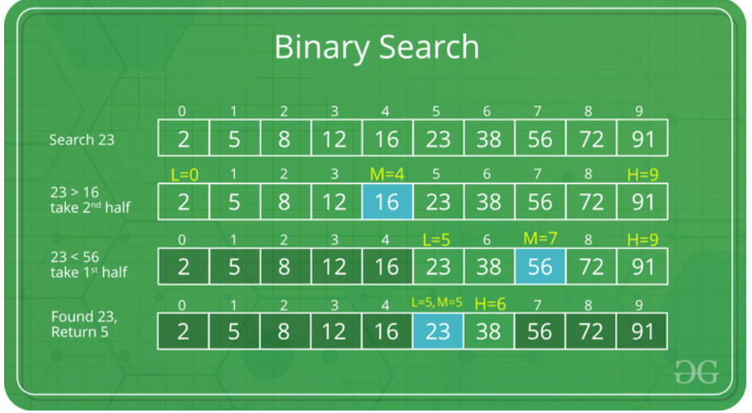
ILLUSTRATION of Binary Search Algorithm
Steps for solution:
1.Compare x with the middle element.
2.If x matches with the middle element, we return the mid index.
3.Else If x is greater than the mid element, then x can only lie in the right half subarray after the mid element. So we recur for the right half.
4.Else (x is smaller) recur for the left half.

Slide 6
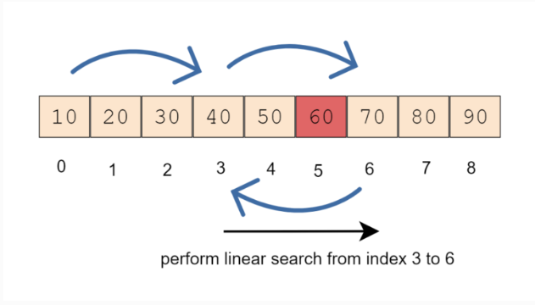
Jump Search Algorithm
Let us understand with an example. We have elements 10, 20, 30, 40, 50, 60, 70, 80, 90 and we are searching for element 60. In our example, the array is sorted so we can skip it.
Calculate the block size to jump i.e √9 = 3. So we will traverse the given sorted array and skip 3 elements each time.
At each step, we will compare the current element value with the search element. If the current element is less than the search element, continue jumping to the next block. If the current element is greater than the search element then perform a linear search from the previous step element to the current step element.
In our example, we started searching for element 60 from index 0 and jumped to index 3 and then to index 6. When we found that the current element at index 6 is 70 and it is greater than the current value of 60. So we start searching element from the previous index (3) to the current index (6).

Slide 7
Interpolation Search
Consider two arrays:
Array 1: 1 3 8 9 12 14 27 29 34 37
Array 2: 10 20 30 40 50 60 70 80 90 100 110 120
Both of the above arrays are sorted in ascending order, but if you observe closely Array 1 is not uniformly distributed, but Array 2 is uniformly distributed, that is, the elements in Array 2 are placed in regular intervals of equal size, in our case 10.
Now if we want to search element 110 in Array 2, and we go by the normal binary search it will first select the middle element and then reach 110 dividing array into half each time.

Slide 8
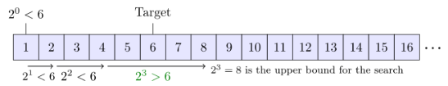
Exponential Search
Exponential Search also known as finger search, searches for an element in a sorted array by jumping 2^i elements every iteration where i represents the value of loop control variable, and then verifying if the search element is present between last jump and the current jump.

Slide 9

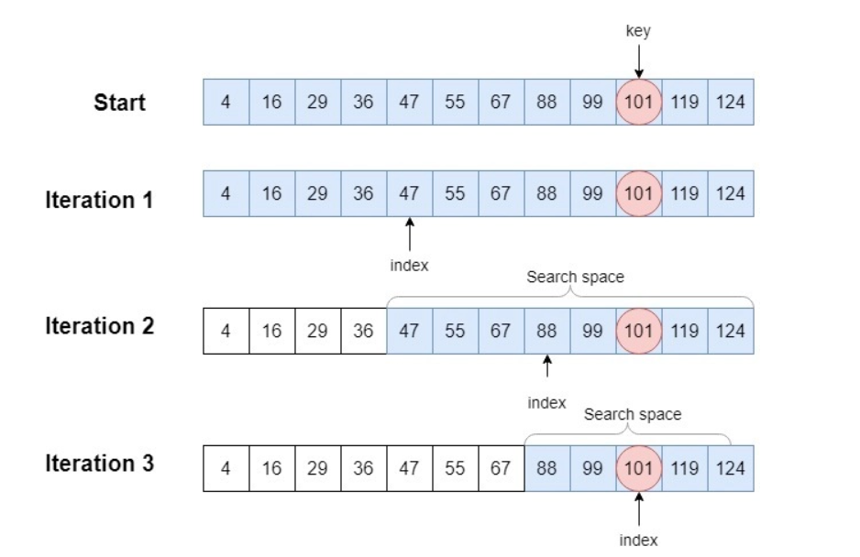
Fibonacci Search
Mathematically, we can define the Fibonacci numbers with the following recurrence equation:
From here, we invoke the Fibonacci search to find key 101.
Iteration 1: We start with full array so n=12 and offset=-1. So, the smallest Fibonacci number >= 12 is 13. From this, we find F_{k}=13, F_{k-1}=8, and F_{k-2}=5. Next, we compute index=min{(offset+F_{k-2}), n-1)}=min((-1+5), 11)=4. The element at index 4 in arr is 47. Since 101>=47, we move one Fibonacci number down.
Iteration 2: F_{k}=8, F_{k-1}=5, F_{k-2}=3. We compute index=min{(offset+F_{k-2}), n-1)}=min((4+3), 11)=7. The element at index 7 in arr is 88. Since 101>= 88, we move one Fibonacci number down.
Iteration 3: F_{k}=5, F_{k-1}=3, F_{k-2}=2. We compute index=min{(offset+F_{k-2}), n-1)}=min((7+2), 11)=9. The element at index 9 in arr is 101. Since 101=101, we return index and stop.

Slide 10
Thanks for your attention
Prepared by Punhan Aliyeva

